Slide 1

Hempel Wealth Management Top 50 Index

Slide 2
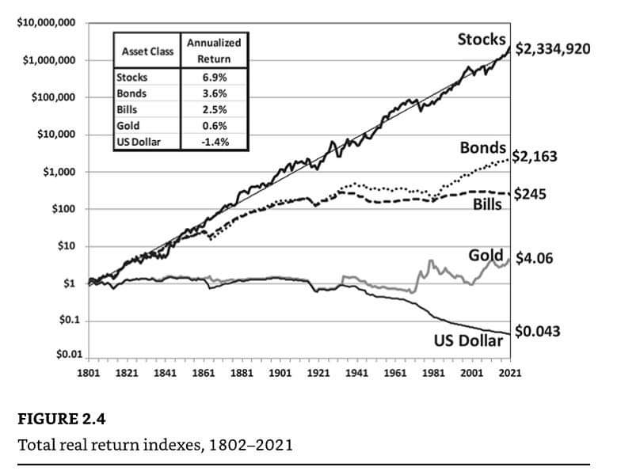
Stocks for the Long Run
Stocks have drastically outperformed other investment asset classes over the last 200 years.
Every year S&P publishes the SPIVA Scorecard which measures investment funds vs. stock market index.
Past 3-years, 86% of large-cap funds have underperformed the S&P 500 (large cap) index
Past 20-years, 95% of large-cap funds have underperformed the S&P 500 index
100% of large-cap growth funds underperformed the S&P 500 Growth index based on risk-adjusted returns over the last 20-years
Disclaimer: The results are hypothetical results and are NOT an indicator of future results and do NOT represent returns that an investor actually attained. Indexes are unmanaged, do not reflect management or trading fees, and one cannot invest directly in an index.
Source: Stocks for the Long Run - Jeremy Siegel; SPIVA Scorecard at https://www.spglobal.com/spdji/en/documents/spiva/spiva-us-mid-year-2022.pdf

Slide 3

Investment Factors
Formal academic models have explained individual stock performance since the 1960s. In the research since, roughly 500 factors have been documented that explain individual stock outperformance, organized into the following categories:
Size
Value
Investment
Momentum
Expected Growth
Profitability / Quality
High Beta vs. Low Volatility

Slide 4
Traditional Factors
Volatility: While high beta historically was associated with higher absolute returns, the low volatility stocks have delivered higher risk-adjusted returns. Many investors, such as individuals, pension funds and mutual funds, are constrained in the leverage that they can take, and therefore must overweight riskier securities instead, creating a Low volatility anomaly.
Small Size: One of the oldest and most persuasive arguments in the stock market is that small stocks outperform large stocks. However, recent research to suggest that “There Is No Size Effect”
Value: the most famous factor, is the tendency for relatively cheap stocks to outperform relatively expensive stocks over time. Recent academic research suggests the value factor can be eliminated since it can be better explained using other factors

Slide 5
Modern Factors
Momentum is the tendency for past price performance to continue in the near future. However, the q-factor model has found that the Momentum factor can be explained by a combination of Profitability and Expected Growth.
Profitability is the observation that investing in highly profitable stocks tend to significantly outperform companies of lower profitability.
Investment is the observation that firms that are more conservative in asset growth have higher future returns.
Expected Growth is a combination of the firm’s valuation, cash flow, and profitability.

Slide 6
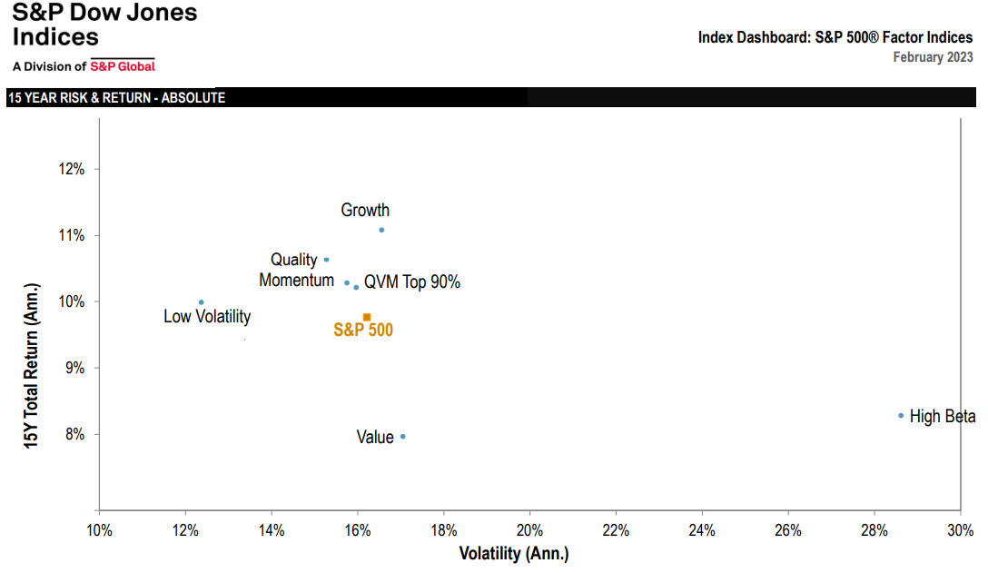
Disclaimer: The results are hypothetical results and are NOT an indicator of future results and do NOT represent returns that an investor actually attained. Indexes are unmanaged, do not reflect management or trading fees, and one cannot invest directly in an index.
Source: https://www.spglobal.com/spdji/en/documents/performance-reports/dashboard-sp-500-factor.pdf
Notes:
15 years of factor risk-adjusted performance

Slide 7
Bloomberg Investment Models

Slide 8
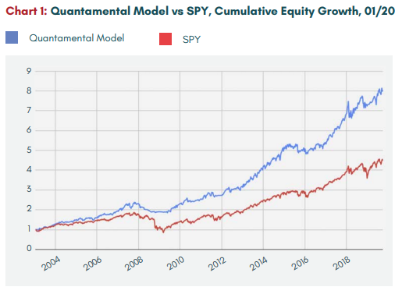
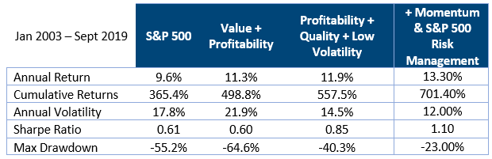
Quantamentals Model
Model:
Low Volatility, Value, Profitability, & Momentum, Market Momentum
Rank and select best 20 stocks, rebalance monthly
Timeframe: Jan 2003 to Sept 2019
Results:
Produced a 40% annualized improvement vs. the market with less risk.
Double the cumulative return over 15 years.
Disclaimer: The results are hypothetical results and are NOT an indicator of future results and do NOT represent returns that an investor actually attained. Indexes are unmanaged, do not reflect management or trading fees, and one cannot invest directly in an index.
Source: https://cmtassociation.org/wp-content/uploads/2020/03/Cain-and-Connors-2020-Dow-Award-1.pdf
Notes:
40% more return per year

Slide 9
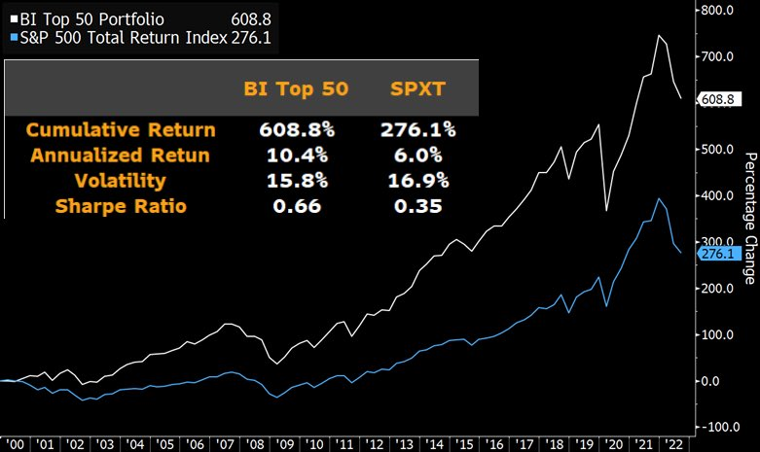
Bloomberg Top 50 Portfolio
Model:
Low Volatility, Value, Profitability, & Momentum
Sector balanced to match S&P 500
Select 50 highest total scores and rebalance quarterly
Timeframe: Jan 2000 to Sept 2022
Results:
Produced a 75% annualized improvement vs. the market with less risk
Double the cumulative return over 22 years
Description | Annual Returns | Volatility | Portfolio Value
S&P 500 Total Return | 6.27% | 16.9 | $4,050,000
Bloomberg Top 50 | 10.4% | 15.8 | $7,090,000
Disclaimer: The results are hypothetical results and are NOT an indicator of future results and do NOT represent returns that an investor actually attained. Indexes are unmanaged, do not reflect management or trading fees, and one cannot invest directly in an index.
Source: https://twitter.com/GinaMartinAdams/status/1598431923294150656?cxt=HHwWgIC9mbHX4q4sAAAA
Notes:
75% more return per year

Slide 10
Recreating the Bloomberg Model
Question: Can the outperformance of Bloomberg Top 50 Portfolio be reproduced?
Model: Bloomberg Top 50 Portfolio
Quarterly Rebalanced, Sector Neutralized, Portfolio size of 50
Time period: 2000-1-1 to 2022-9-30
Results:
Yes. Near identical replication in Returns and Volatility to the Bloomberg Top 50 Model, which uses Bloomberg source data vs. the Hempel Wealth reproduction using data from Refinitiv (aka Thompson Reuters). We now have a high degree of confidence our data model is robust allowing for further analysis.
Description | Annual Returns | Volatility | Portfolio Value
Bloomberg Top 50 | 10.4% | 15.8 | $7,090,000
Recreate Bloomberg Model | 10.5% | 15.7 | $7,350,000
Disclaimer: The results are hypothetical results and are NOT an indicator of future results and do NOT represent returns that an investor actually attained. Indexes are unmanaged, do not reflect management or trading fees, and one cannot invest directly in an index.
Source: Refinitiv, Hempel Wealth Management LLC

Slide 11
Warren Buffett & Berkshire Hathaway

Slide 12
Whitepaper: Buffett’s Alpha (Pedersen 2013)
Berkshire Hathaway has a significant outperformance in investment returns that can not be explained using traditional factors [Beta, Size, and Value]. However, this unexplained outperformance disappears when controlling for Low Volatility and Profitability factors.
In short, Buffett’s returns appear to be neither luck nor magic, but, rather, reward for the use of Low Volatility, Value, and Profitable stocks.
How did Buffett become among the richest in the world?
The answer is that Buffett has boosted his returns by using leverage, and that he has stuck to a good strategy for a very long time period, surviving rough periods where others might have been forced into a fire sale or a career change. Pedersen estimates that Buffett applies a leverage of about 1.6-to-1 on average and he has been doing it for over half a century.
Disclaimer: The results are hypothetical results and are NOT an indicator of future results and do NOT represent returns that an investor actually attained. Indexes are unmanaged, do not reflect management or trading fees, and one cannot invest directly in an index.
Source: https://www.nber.org/papers/w19681

Slide 13
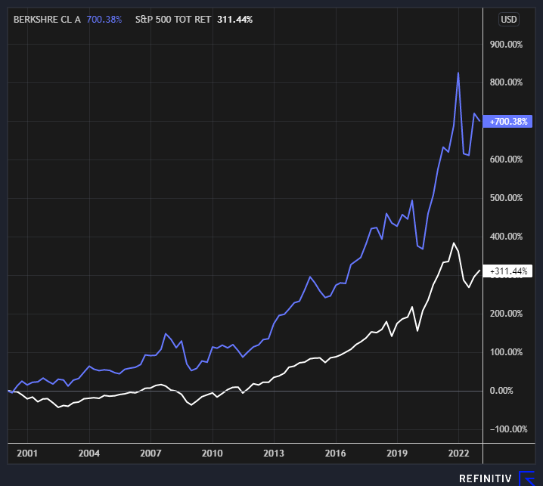
Berkshire Hathaway Stock
Model:
100% Berkshire Hathaway Class A Stock
Historically, Warren Buffet’s investment approach can be described as a 1.6x leveraged portfolio using Value, Quality, Low Volatility Factors
Timeframe: Jan. 1, 2000, to Dec. 31, 2022
Results:
More than double the cumulative return of the S&P 500 since January 2000.
Disclaimer: The results are hypothetical results and are NOT an indicator of future results and do NOT represent returns that an investor actually attained. Indexes are unmanaged, do not reflect management or trading fees, and one cannot invest directly in an index.
Source: Refinitiv, Hempel Wealth Management LLC

Slide 14
The Simplified Buffett Model
Model: Buffett Factors
Quarterly Rebalanced, Portfolio size of 50
Max Drawdown -36.4% vs. S&P500 -45.8%
Time period: 2000-1-1 to 2022-12-31
Results:
Very similar results to the actual returns of Berkshire Hathaway Class A Stock during the time period even though Berkshire portfolio is not rebalanced quarterly and uses significant leverage.
Description | Annual Returns | Volatility | Portfolio Value
S&P 500 Total Return | 6.27% | 16.9 | $4,050,000
Simplified Buffett Model | 9.75% | 14.3 | $8,500,000
Disclaimer: The results are hypothetical results and are NOT an indicator of future results and do NOT represent returns that an investor actually attained. Indexes are unmanaged, do not reflect management or trading fees, and one cannot invest directly in an index.
Source: Refinitiv, Hempel Wealth Management LLC

Slide 15
Hempel Wealth Models
There is a significant difference in portfolio construction if the investment account can use leverage.
Many investors, such as retirement accounts, pension funds and mutual funds, are constrained in the leverage that they can take, and therefore must overweight riskier securities instead. This approach has historically resulted in lower risk-adjusted returns.

Slide 16
Hempel Wealth Top 50
Model: Hempel Wealth Top 50
Quarterly Rebalanced, Portfolio size of 50
Max Drawdown -35.3% vs. S&P500 -45.8%
Time period: 2000-1-1 to 2022-12-31
Results:
Nearly double the annual return with lower volatility.
Description | Annual Returns | Volatility | Portfolio Value
S&P 500 Total Return | 6.27% | 16.9 | $4,050,000
Hempel Wealth Top 50 | 11.90% | 15.0 | $13,280,000
Disclaimer: The results are hypothetical results and are NOT an indicator of future results and do NOT represent returns that an investor actually attained. Indexes are unmanaged, do not reflect management or trading fees, and one cannot invest directly in an index.
Source: Refinitiv, Hempel Wealth Management LLC

Slide 17
Hempel Wealth Top 50 Low Volatility
Model: Hempel Wealth Top 50 Low Volatility
Quarterly Rebalanced, Portfolio size of 50
Max Drawdown -35.2% vs. S&P500 -45.8%
Time period: 2000-1-1 to 2022-12-31
Results:
Over double the annual return, nearly 4 times the cumulative return on a risk-adjusted basis.
Description | Annual Returns | Volatility | Portfolio Value
S&P 500 Total Return | 6.27% | 16.9 | $4,050,000
Hempel Wealth Top 50 Low Vol | 11.67% | 14.0 | $12,660,000
Market Risk Adjusted | 14.03% | 16.9 | $20,470,000
Disclaimer: The results are hypothetical results and are NOT an indicator of future results and do NOT represent returns that an investor actually attained. Indexes are unmanaged, do not reflect management or trading fees, and one cannot invest directly in an index.
Source: Refinitiv, Hempel Wealth Management LLC

Slide 18
Applicability for Clients
The Hempel Wealth Top 50 and the Top 50 Low Volatility Portfolios are only available to clients
The Top 50 Portfolio is ideally suited for retirement accounts (IRA & 401k) where the use of leverage is not available and rebalancing the portfolio’s realized gains/losses does not generate a tax impact
The Top 50 Low Volatility Portfolio is ideal for clients with more conservative investment goals or clients with more aggressive investment return goals that can use leverage to mimic Warren Buffett approach
Both models historically generated above market returns, which allows the possibility to reduce the percentage of the portfolio invested in equities (and still generate market like returns). The freed-up cash could be invested into other asset classes increasing diversification or increasing income generation.

Slide 19
Hempel Wealth Index Approach
The models are developed to avoid survivorship bias and look-ahead bias. Only stocks that were in the universe at a given point in time are included, regardless of whether those stocks are currently active.
Historical results include large numbers of dead securities. When creating historical scores, wherever possible only data as was then available is used.
Since the components and final model ranks are all ranked relatively, it is possible that a company can look weaker on the components, but when those components are combined, the overall score is higher than any individual components. This can be thought of in the sense of a triathlon, where an athlete does not necessarily need to place first in the three events to still be the overall winner.
Disclaimer: The results are hypothetical results and are NOT an indicator of future results and do NOT represent returns that an investor actually attained. Indexes are unmanaged, do not reflect management or trading fees, and one cannot invest directly in an index.
Source: Refinitiv, Hempel Wealth Management LLC

